Slide 1

University of Florida Parking Availability Database
Date: Wednesday, February 24, 2021
Presented By:
Abraham Osman , Ellie Shahrabani, Ishaan Dhillon, Amit Som, Robert Van Valkenburgh, Megan Osorio, Alejandra Vila, Rochelle Lieberman

Slide 2
Executive Summary
If UF plans to continue expanding the number of students they are able to offer an education to, both on the undergraduate and graduate level, their parking issue needs to be addressed, and soon.
There is no guarantee of a parking spot when you arrive on campus, even if you have paid for a decal. In addition, very few lots are open to the public at all hours of the day.
This database will only add to UF’s stellar academic success, by reducing the stress of those having to come on campus to find parking as well as motivate more students to attend class regularly and on time.
Notes:
Amit

Slide 3
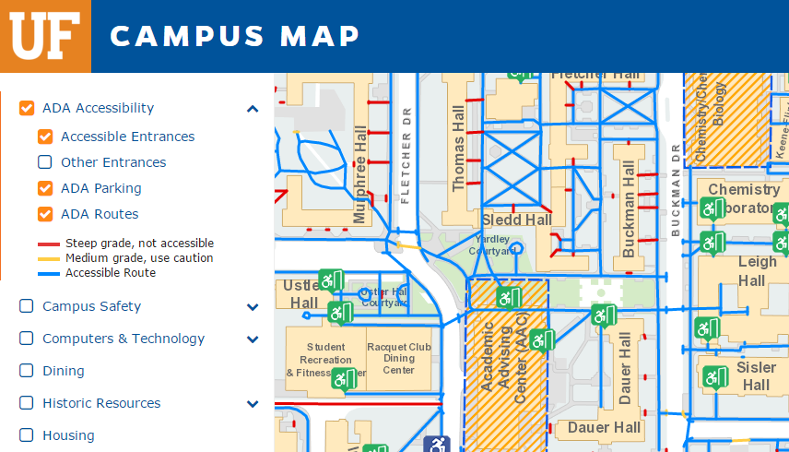
Objective
The 3 Key Functions of our program:
Identify which parking lots have available spots
Help students locate their cars
Notify other users of when spots will be made available
Assist UF TAPS in determining parking violations
Our database will collect the data required to complete these functions
including but not limited to...
Notes:
Megan

Slide 4


Data Collected
Name
License plate
Type of vehicle (car, truck, scooter, etc)
Make/model
Parking lot name
Decal type
Time limit in particular spots
Amount of filled spots in parking lot
Amount of vacant spots in parking lot
Notes:
Bram

Slide 5
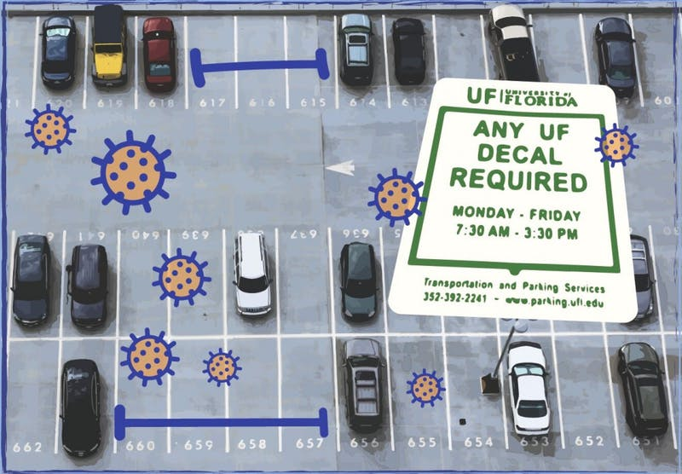
Assumptions
The main assumptions we’re making are:
UF parking is operating at full capacity (COVID19)
App logs the time allotted once user has confirmed they’ve parked
Each parking lot has the capacity of spots that we assigned to them.
Any user who breaches parking app rules WILL automatically be granted a violation and possible fine
UF has two decals -- Red for students and Orange for professors
The supply of parking spaces is assumed to be fixed
Notes:
Alejandra

Slide 6
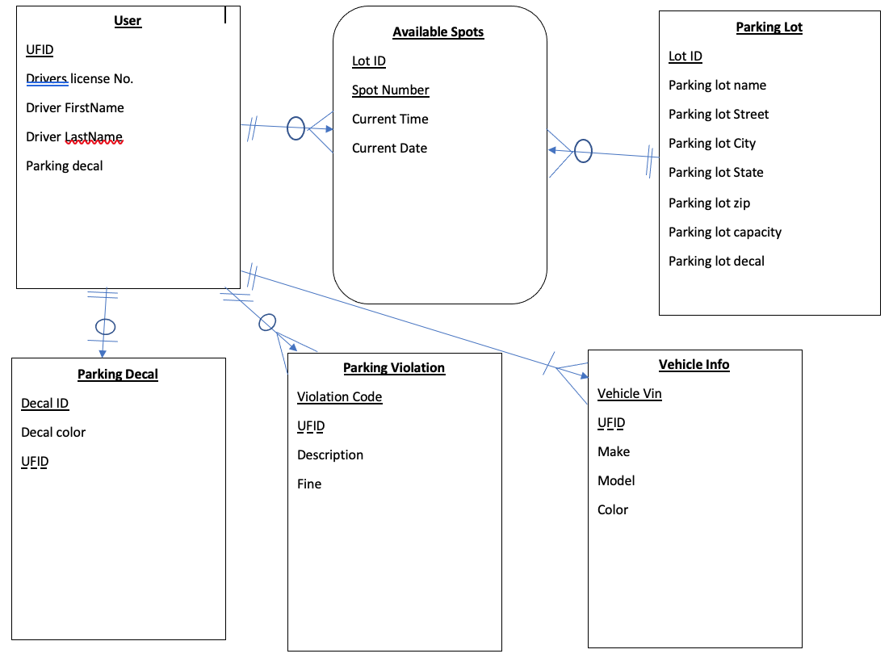
ER Model
Notes:
Ishaan

Slide 7
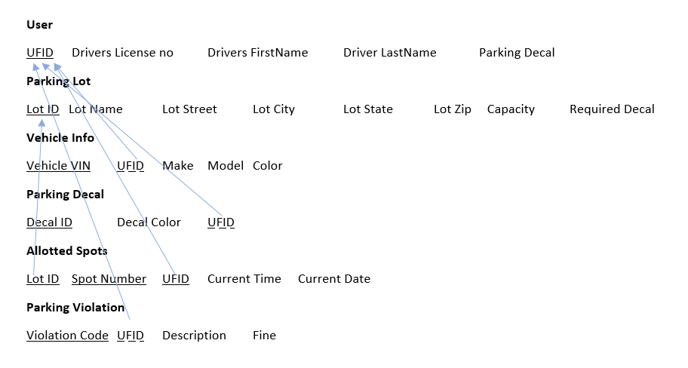
Logical Schema
Notes:
Rochelle

Slide 8
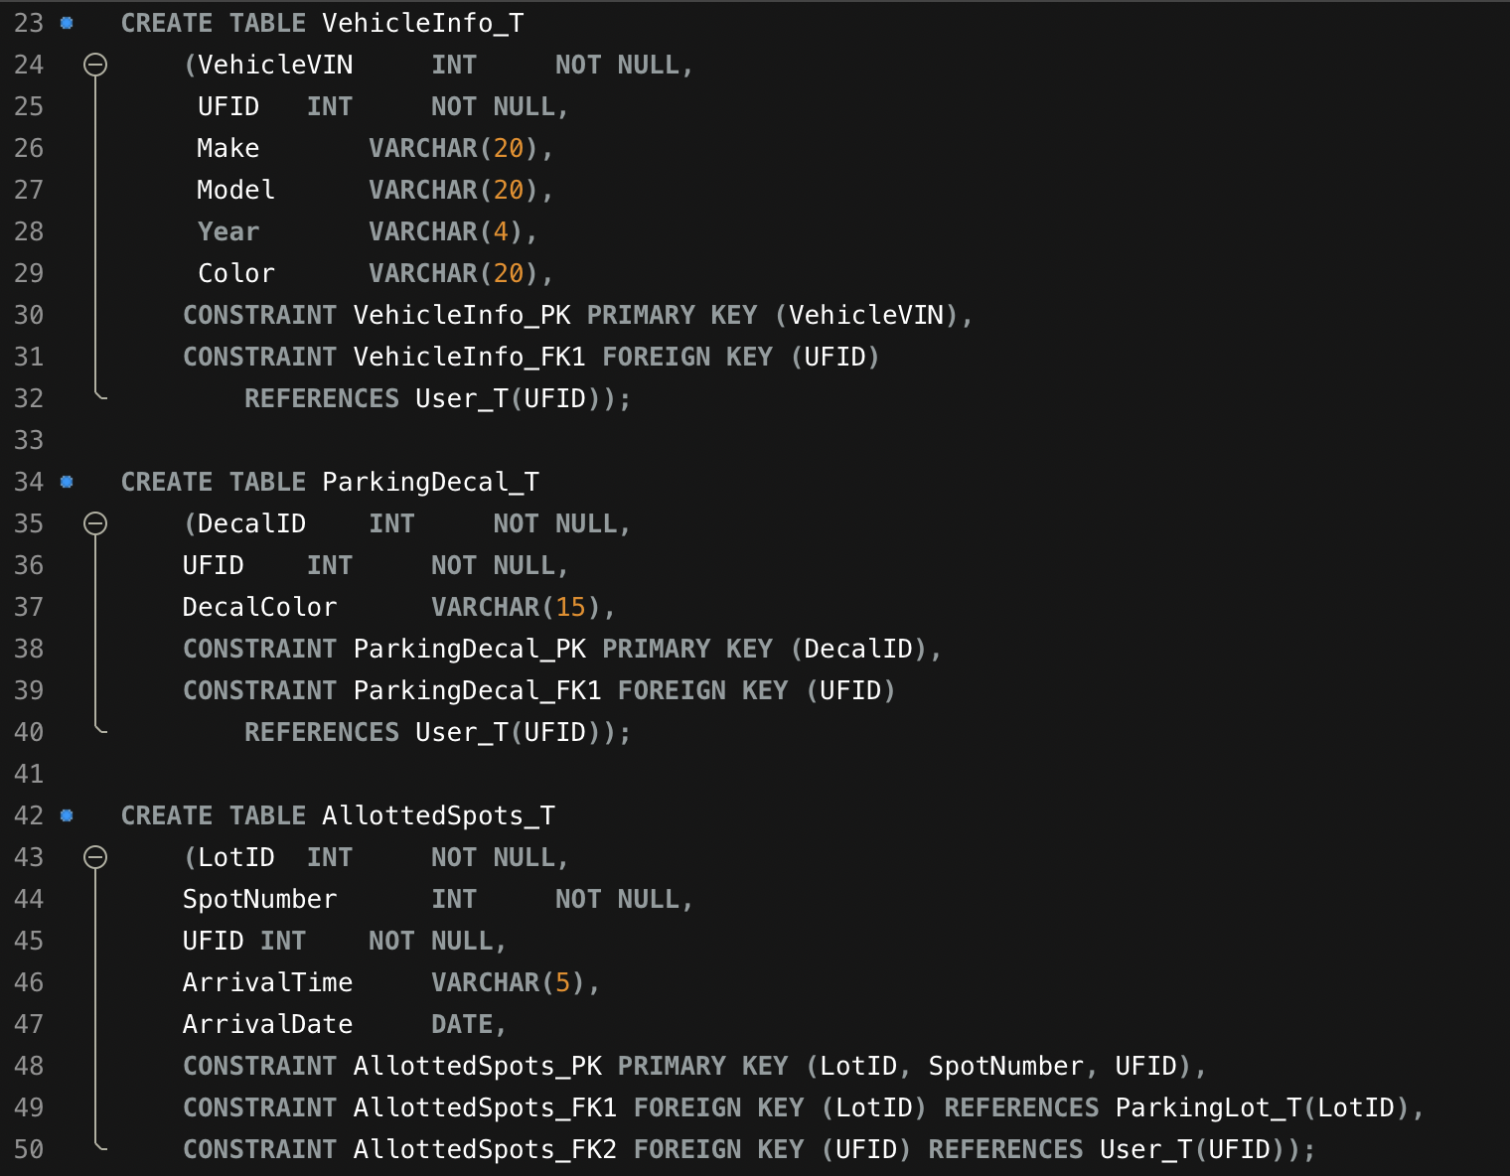
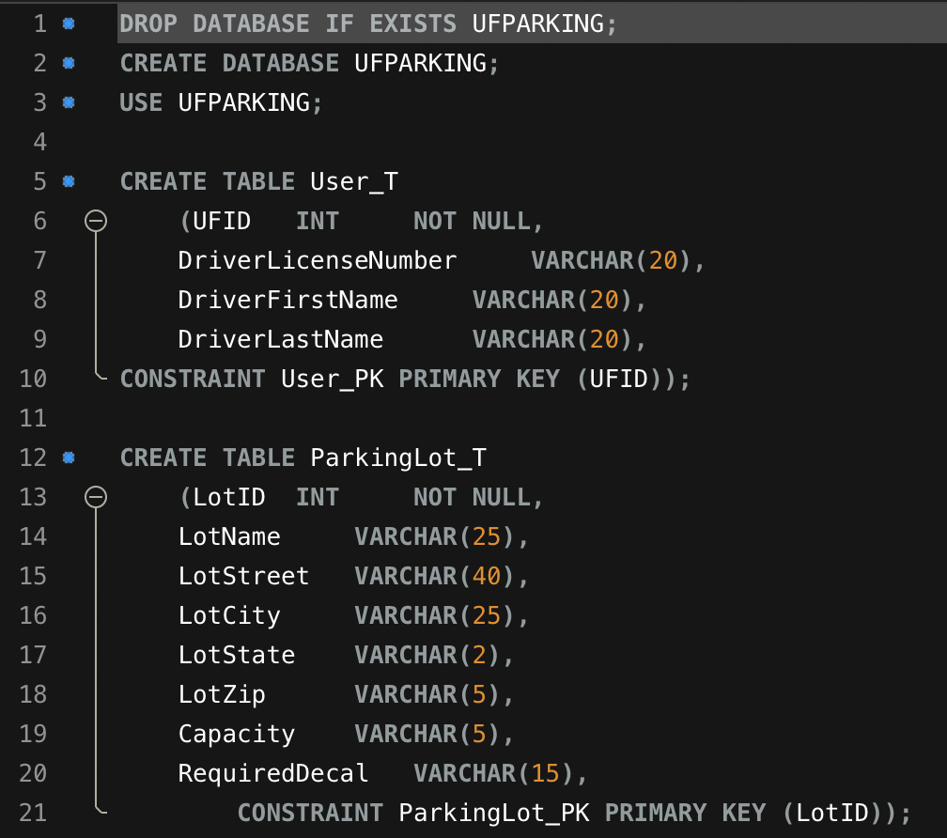
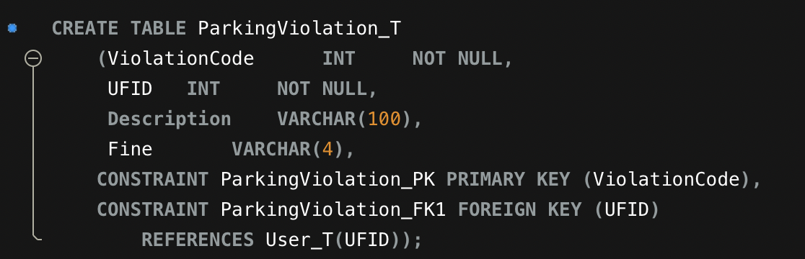
Our SQL Code
Notes:
Ellie

Slide 9
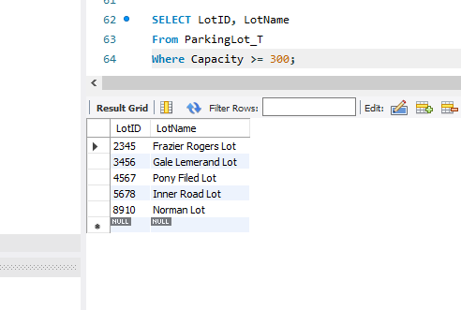
SQL Queries
List the parking lots that have a total capacity of 300 or more spots:
SELECT LotID, LotName
From ParkingLot_T
Where Capacity >= 300;
Notes:
Robert

Slide 10
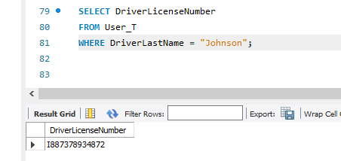
Queries Continued
2.
Find the driver’s license number of the user with the last name Johnson:
SELECT DriverLicenseNumber
FROM User_T
WHERE DriverLastName = "Johnson";

Slide 11
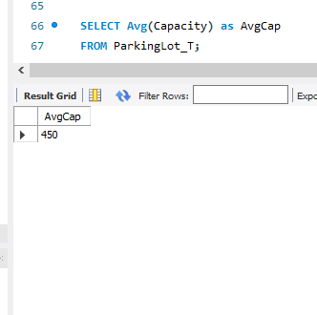
Queries Continued
3.
Find the average size of the parking lots at the University of Florida:
SELECT Avg(Capacity) as AvgCap
FROM ParkingLot_T;

Slide 12
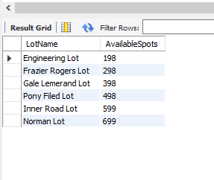
Queries Continued
4.
List the number of currently available spots in each parking lot:
SELECT ParkingLot_T.LotName, Capacity - Count(*) AvailableSpots
FROM ParkingLot_T, AllottedSpots_T
WHERE AllottedSpots_T.LotID = Parkinglot_T.LotID
GROUP BY LotName;

Slide 13
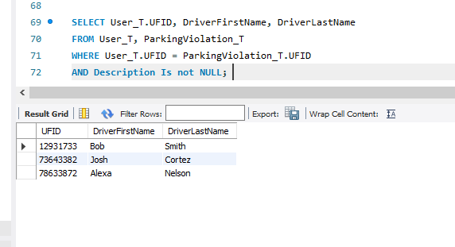
Queries Continued
5.
List the UFID numbers who have received a parking violation:
SELECT User_T.UFID, DriverFirstName, DriverLastName
FROM User_T, ParkingViolation_T
WHERE User_T.UFID = ParkingViolation_T.UFID
AND Description Is not NULL;

Slide 14
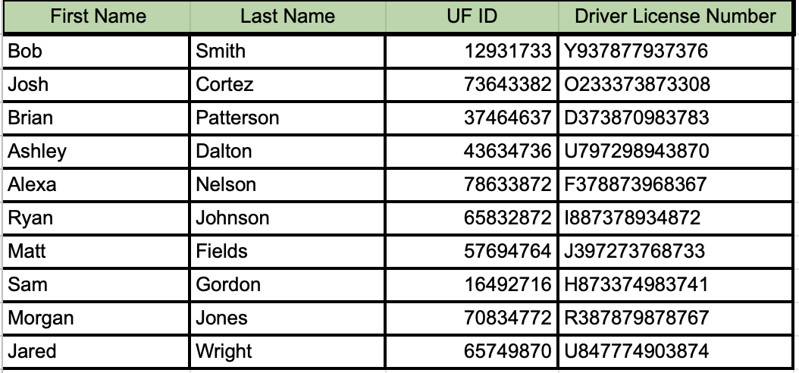
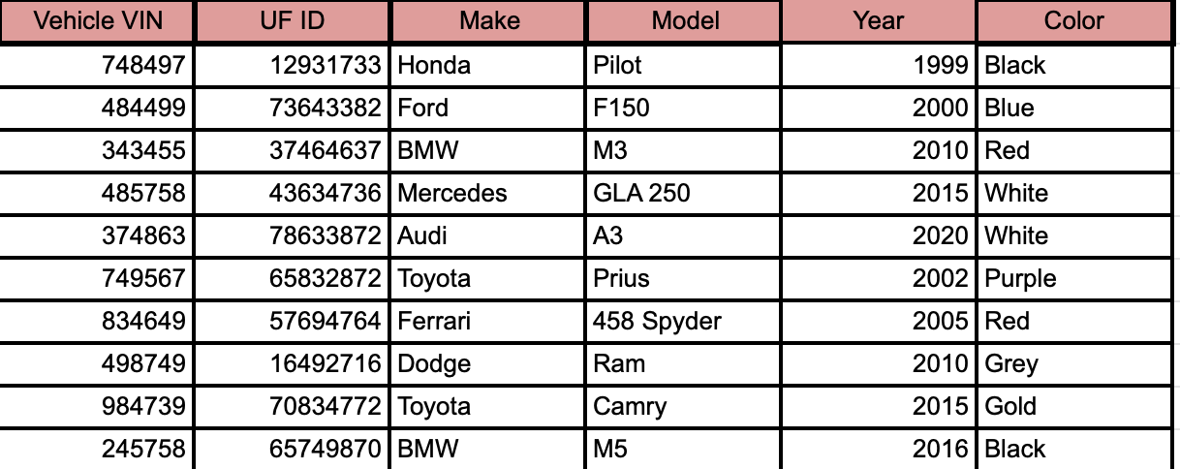
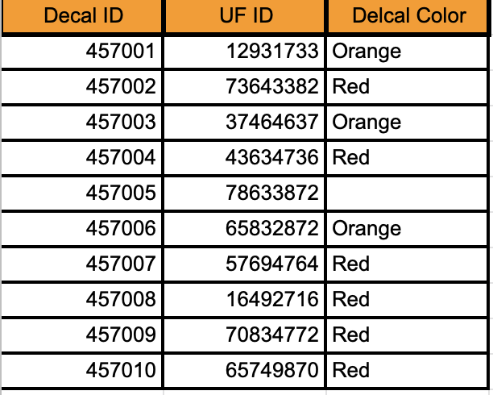
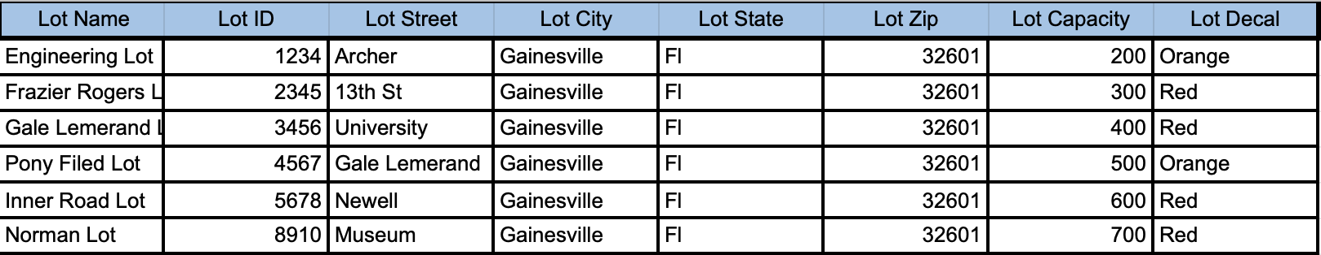
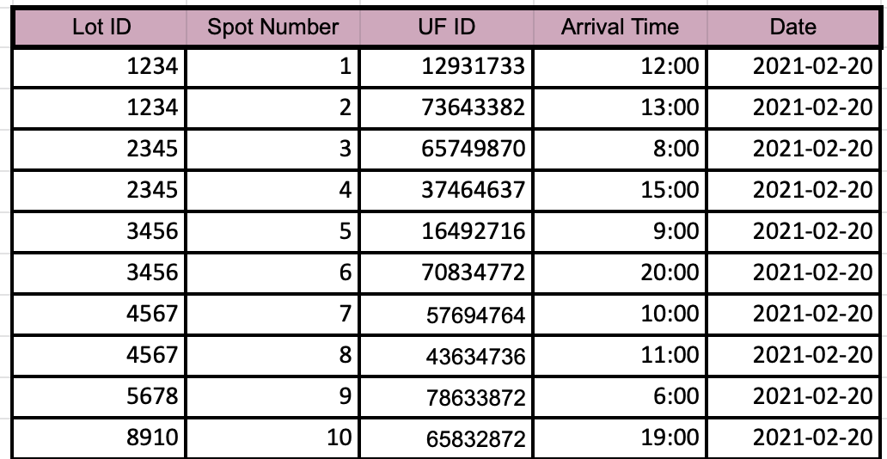
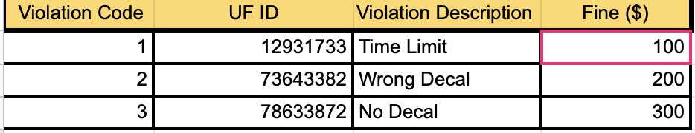
Appendix: Excel Database

